Slide 1
ISE 497-498
Senior Project
Fall 2015

Slide 2
Dersin web sayfasını takip edin
http://fecs.ieu.edu.tr/empf/ise497.html
Duyurular, plan, kurallar, yapılması gerekenler
İlk aşamada proje grubu kurulmalı
Henüz kurmamış olanlar bizimle iletişime geçsin
Gruba bir isim verilmeli
Proje yapılacak bir firma bulunmalı (sigortalama üniversite tarafından yapılacak)
Grup elemanlarının isimleri, email adresleri ve de grup adı, belli olunca firma adı ve proje başlığı email atılmalı (zeynep.sargut@ieu.edu.tr)

Slide 3
Bugün
Size dağıtılacak forma
grup elemanlarının isimlerini
olası şirket(ler)in ismini (isimlerini)
olası proje konusunu (konularını)
çalışmak istediğiniz öğretim üyelerini sırayla (3 tane), belliyse 1 tane yazın.
Dersin sonunda toplanacak
Buna göre danışman ataması yapılacak
Şirket ve proje başlığı kesinleştiğinde Zeynep Sargut’a bildirin.

Slide 4
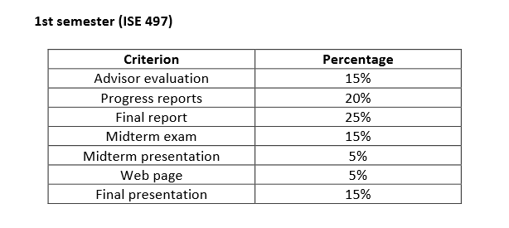
Grading

Slide 5
Schedule
Week 1 » Project selection and team formation, coming up with a team name.
Week 2 » Project selection and team formation, coming up with a team name.
Week 3 » Project proposal (including project schedule) submission
Week 5 » Progress report submission 1
Week 7 » Progress report submission 2
Week 8 » Midterm presentation
Week 9 » Progress report submission 3

Slide 6
Week 9 » Progress report submission 4
Week 11 » Progress report submission 5
Week 13 » Final Report Submission, Midterm Examination
Week 14 » Final presentation

Slide 7
The web page should include
Group name, members
project title, company,
problem definition,
methodology, and
contribution to the firm
progress reports, presentations and other documents related to the project.
*Web page should be up (with basic information) and the address should be emailed to zeynep.sargut@ieu.edu.tr

Slide 8
Oral presentations
There will be a 15-20 minute oral presentation in front of their Examination Committee.
One in the middle
The examination committee will not include the advisor of the team.
At the end of the semester
there will be one session where all professors in the department will evaluate the presentation.

Slide 9
purpose of the midterm presentation
We want to make sure that each team started their project and fully defined their problem and its scope.
The students are also expected to have literature survey on the topic and identify some relevant solution methods
and a road map such as the concrete plan of what they will do through the rest of the semester.

Slide 10
The aim of the final presentation
defend the project and its output.
describe and discuss why each of the critical decisions was made and how it was made.
describe also the deliverables and the important functionalities of the project.

Slide 11
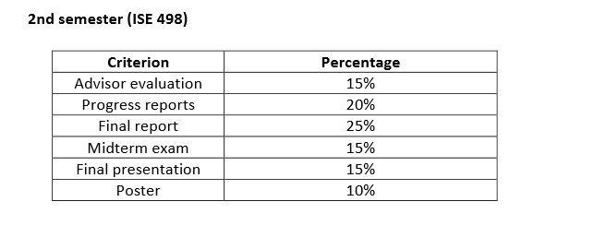
Grading

Slide 12
SGK kaydı
Sigorta işlemleri için
ISE497/498 web sayfasındaki formlar
Nüfus cüzdanı fotokopisi
Bir adet fotoğraf
Adres bilgileri
Dide Somel veya Şeyda Karataş’a teslim edilmelidir.

Slide 13
Başvurulacak yerler
YAEM öğrenci proje yarismasi
Tübitak bursu (1. dönem için)
OR/MS Tomorrow: Undergrad Student Competition. (15th of December)
IIE simulasyon yarışması
TMMOB BİTİRME PROJELERİ SERGİ VE YARIŞMASI

Slide 14
Başvurulacak yerler
http://yaem2015.org/ogrenci-proje-yarismasi/ http://www.tubitak.gov.tr/tr/burslar/lisans/burs-programlari/icerik-2209-b-sanayi-odakli-lisans-bitirme-tezi-destekleme-programi

Slide 15
OR/MS Tomorrow : Undergrad Student Competition. The submissions are due by the 15th of December.
https://www.linkedin.com/grp/post/2112445-6042325230171488259
IIE simulasyon yarışması http://www.iienet.org/Details.aspx?id=3382
TMMOB BİTİRME PROJELERİ SERGİ VE YARIŞMASI
http://www.mmo.org.tr/genel/bizden_detay.php?kod=43309&tipi=2&sube=11#.VfrIGpfSmDk

Slide 16
Meetings with the advisor
Each team should meet with their advisor(s) regularly and submit progress reports (approximately every 2 weeks)
These reports should contain the names of the group members, title of the project, the work carried out in the previous weeks and the work that the team is planning to do in the following week(s)
At the beginning of each term, the teams are expected to prepare a schedule of their project studies

Slide 17
Final Report
Reports should not exceed
15 pages (excluding appendices) in ISE497
30 pages (excluding appendices) in ISE498.

Slide 18
Sections of the Final Report
Title page
Abstract, Keywords
Table of contents
Introduction
Literature survey
Problem definition
Mathematical model (if appropriate)
Solution method
Design of experiments (if appropriate)
Computational results
Conclusion
References
Appendices (if appropriate)

